Slide 1

Lavina Rana, Lauren Hulse, Evan Ingersoll

Slide 2
Problem Statement
Navigation is a big challenge for our users due to flow of the website that continues to cause frustration and form abandonment. Austin Film Festival can make an important change because without upgrading the UX/UI flow, we will not be able to reach our full potential. We can develop new solutions to address the outdated, cluttered, and distracted information that affects our users daily interactions with the website and the brand.
Notes:
Lavina - slack out the link

Slide 3
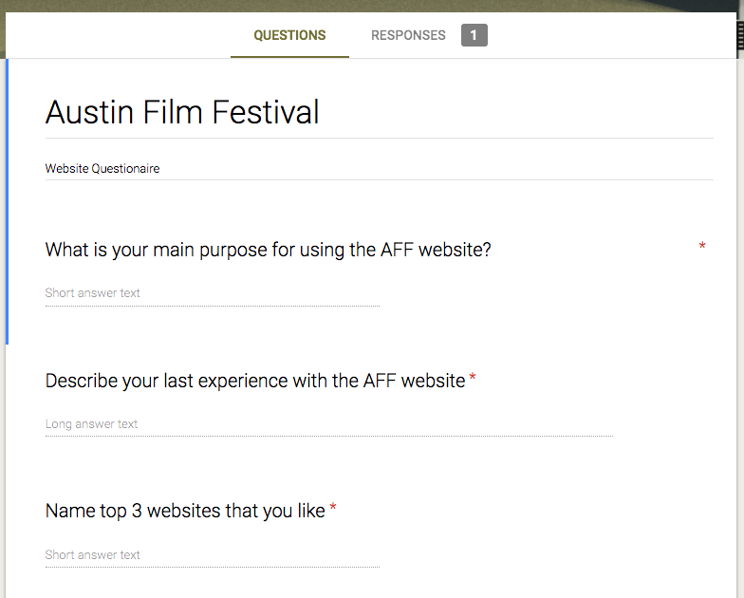
Surveys
Google Forms
Interviews
User & Employee
Notes:
Lavina

Slide 4
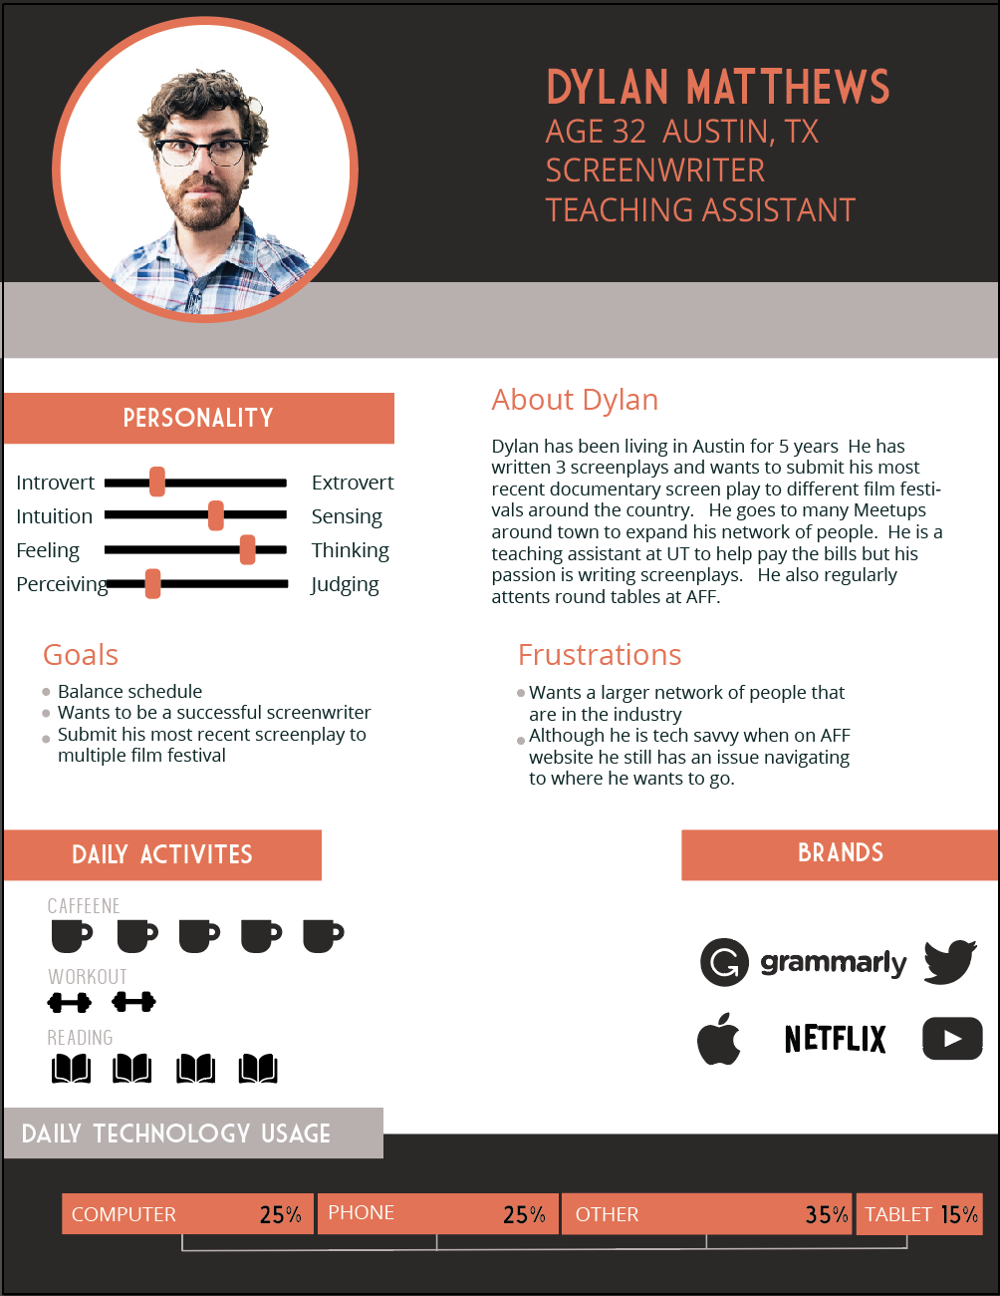
User Persona & Insight
Insight
Less Cluttered
Smoother Flow
Dates of the Festival need to be easily found
Less is More
User App during the Festival
Notes:
Lauren - 2 main users. People trying to Make submissions or people looking to buy badges and passes. We decided to focus on the submission flow.

Slide 5
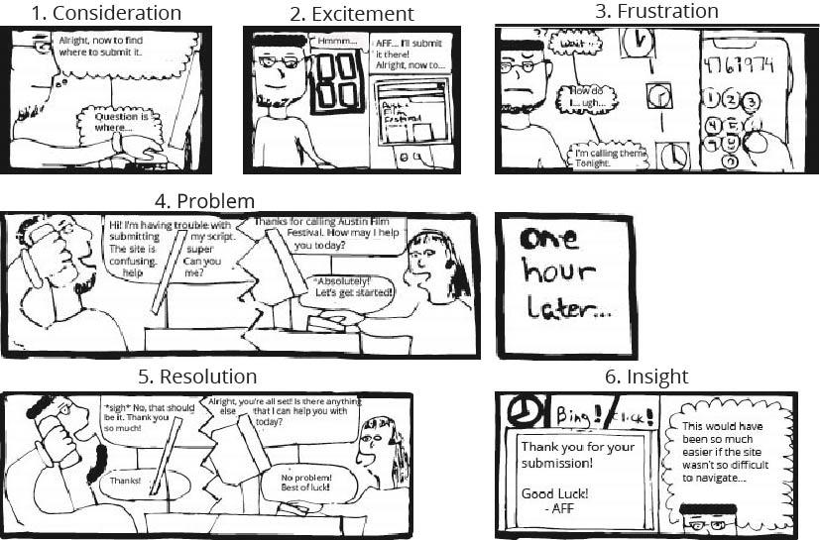
Storyboard & Human Needs
Notes:
Evan - Storyboard addresses how events play out right now, leads into how our fixes should change how the situation plays out. (Important to note that most people calling AFF are from the younger, tech savvy crowd.)

Slide 6
User Scenario
Dylan is a screenwriter and wants to submit his documentary screenplay online for the Austin Film Festival.

Slide 7
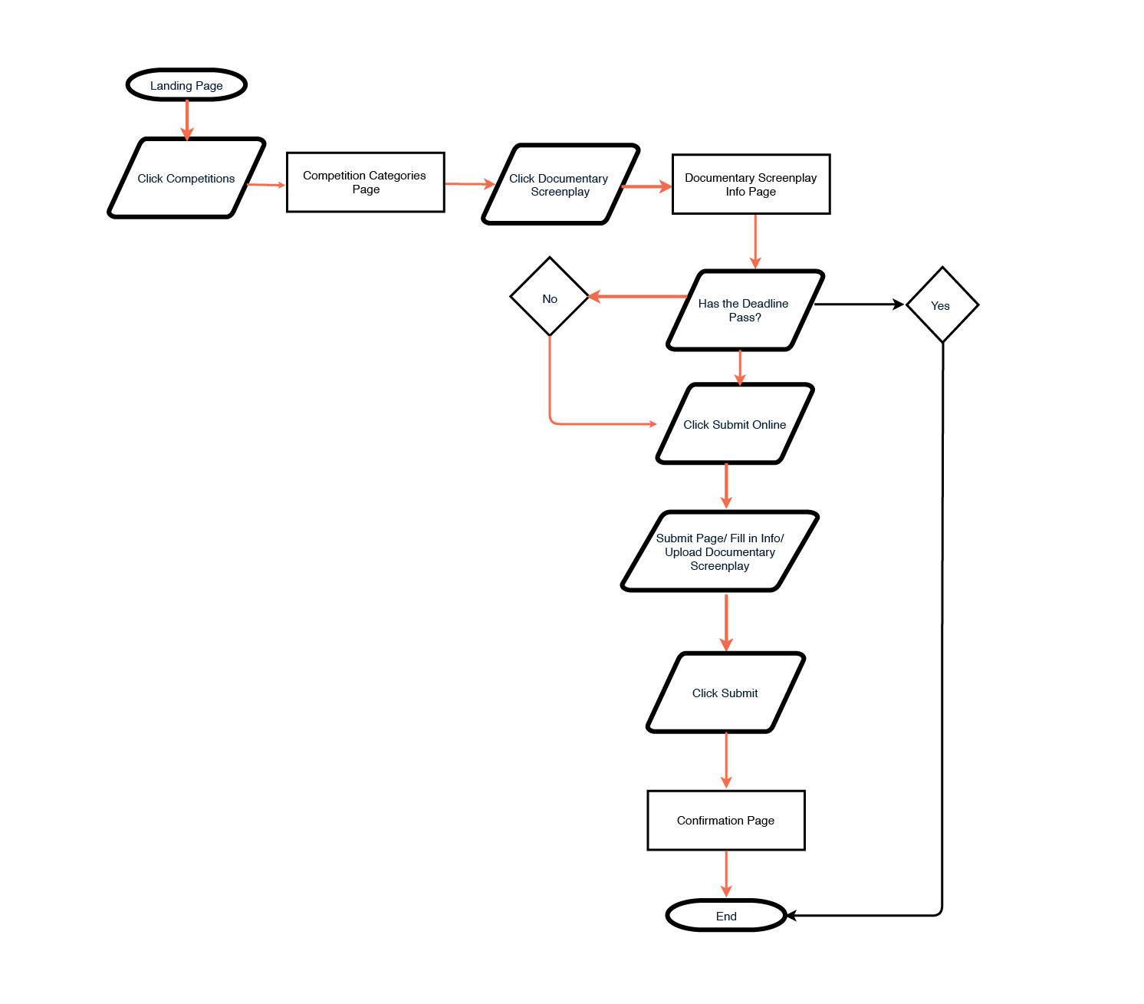
Decision Wireflow
Dylan submits his documentary
screenplay.
Notes:
Evan
From our storyboard this is the decision wire flow we came up with to make it easier for the User to navigate the site.
Deadline has passed -elaborate.

Slide 8
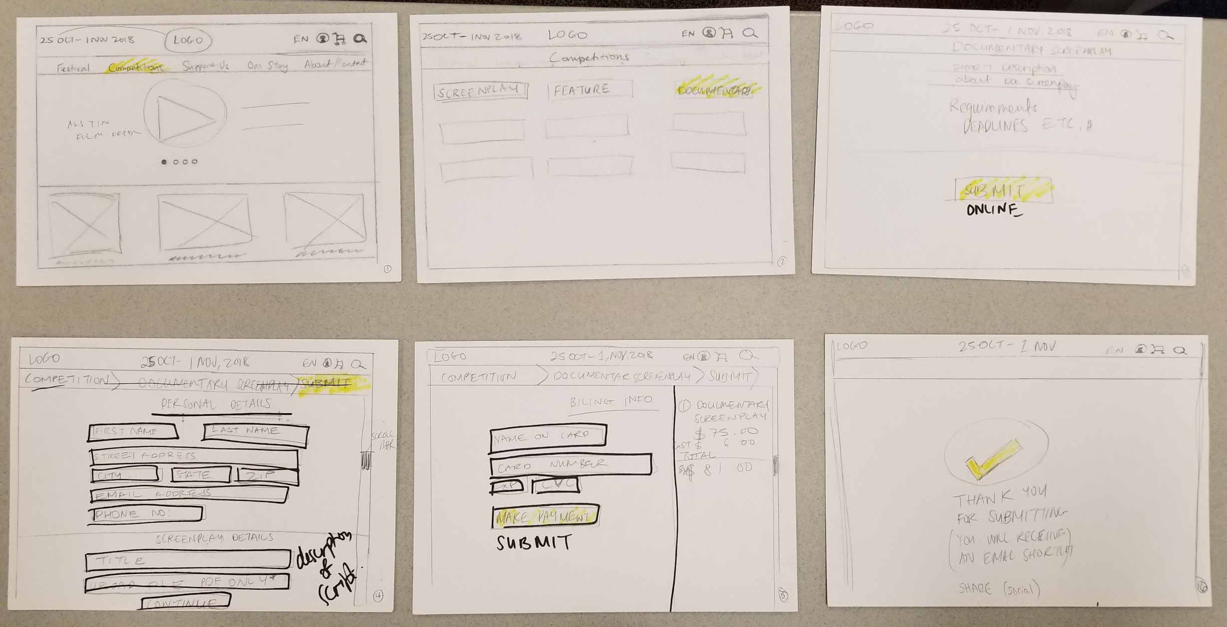
Low Fidelity Prototype / AB Testing
Notes:
Lauren AB testing- Decision for submission page- tabs.
Competition categories.
Making sure the festival date is clear for users and employees. Both Testers liked the B Process better

Slide 9
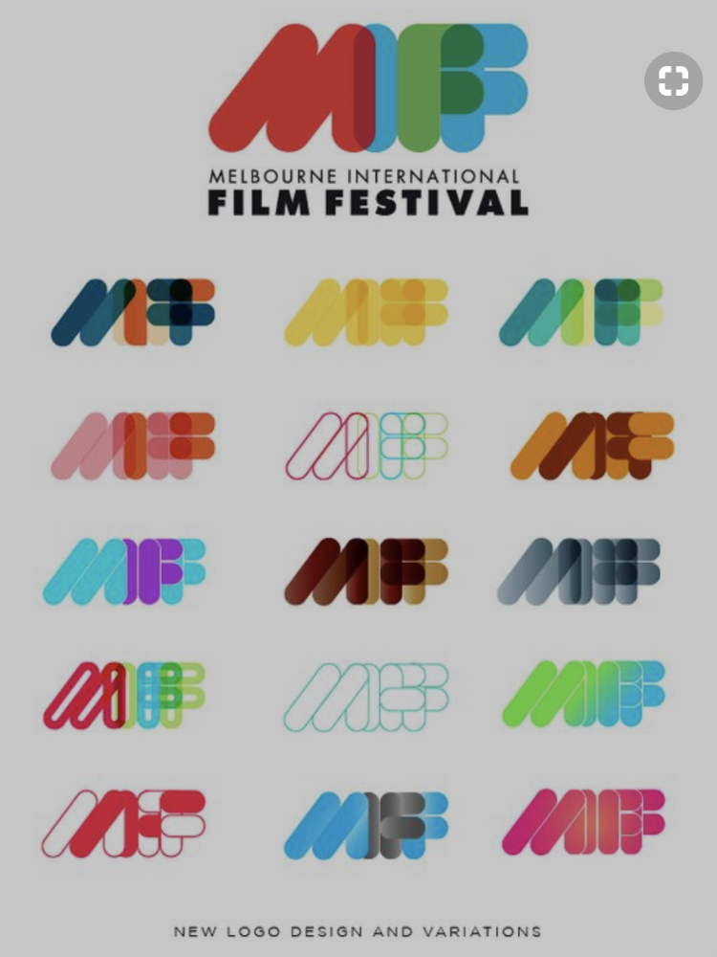


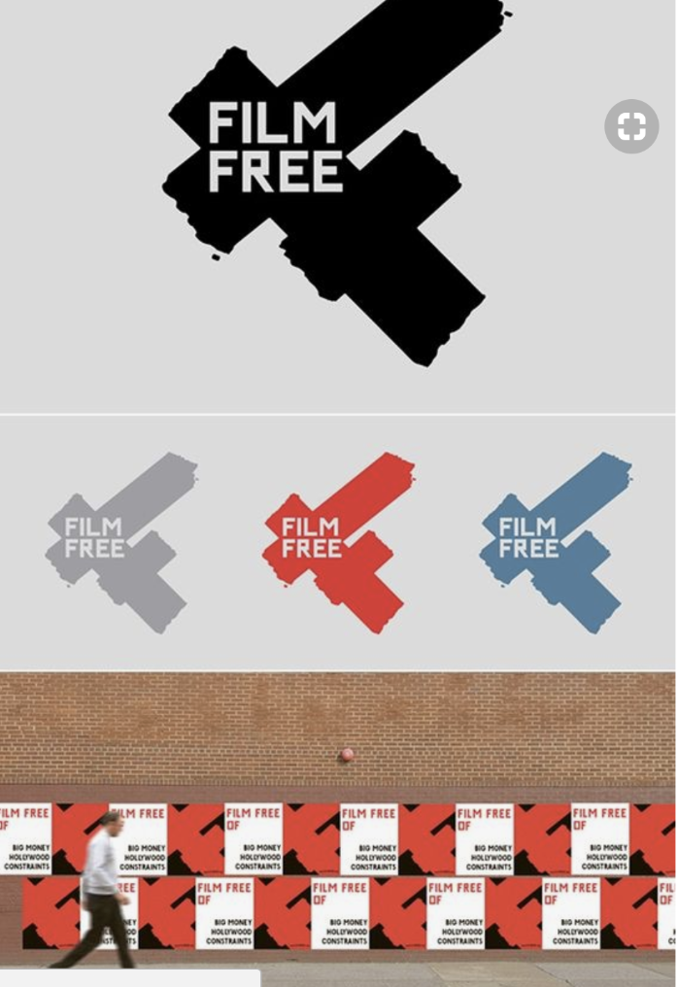
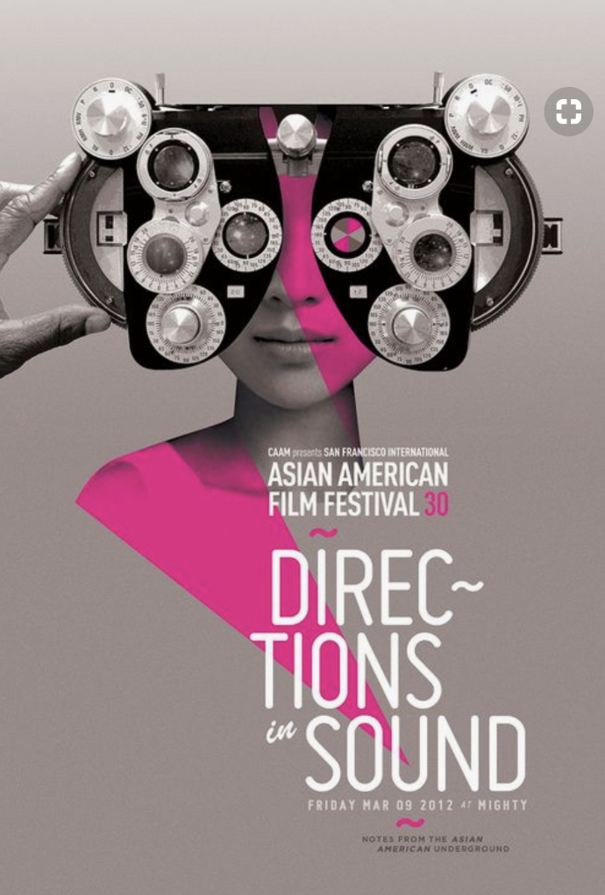
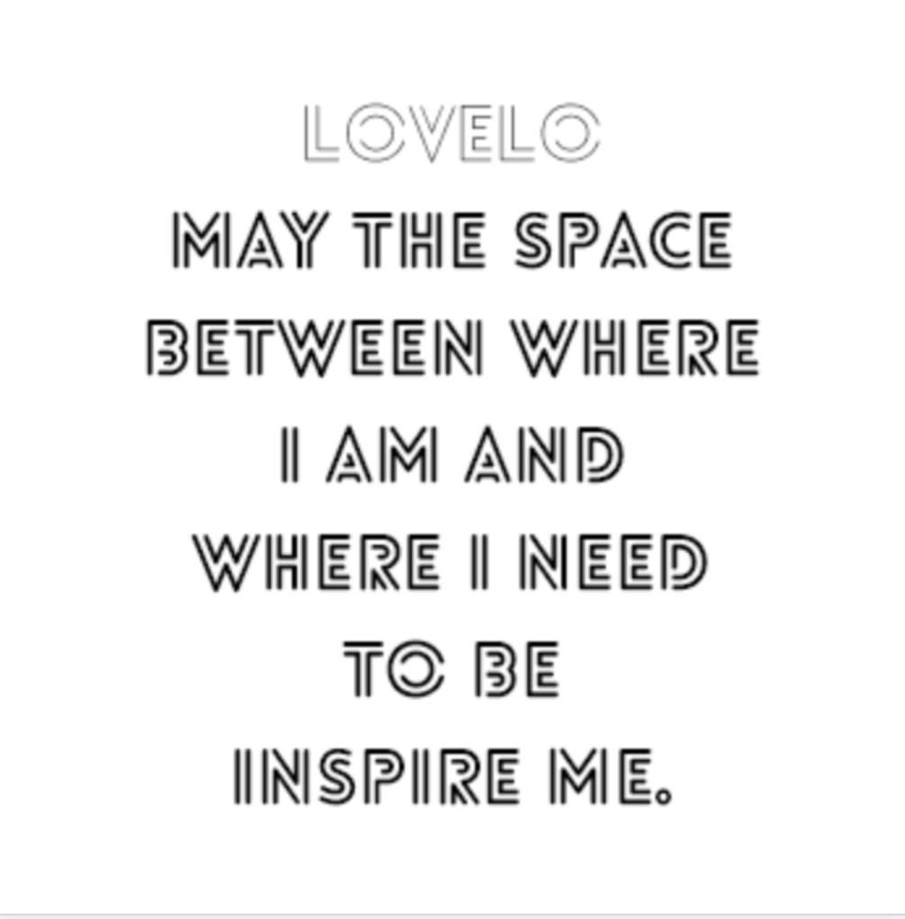
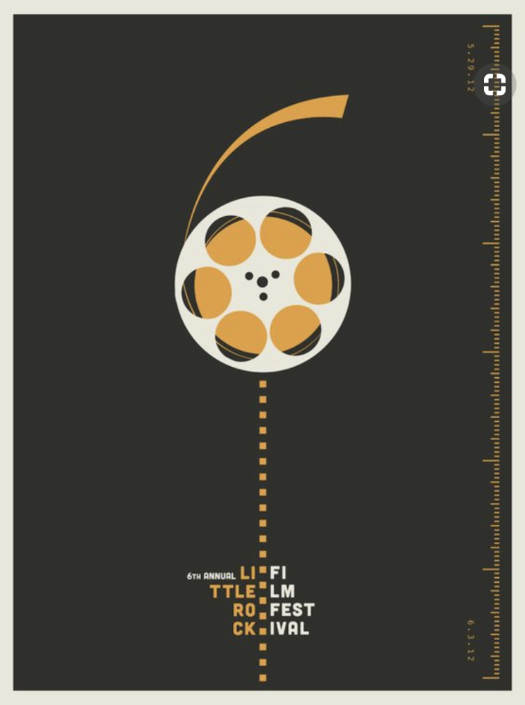
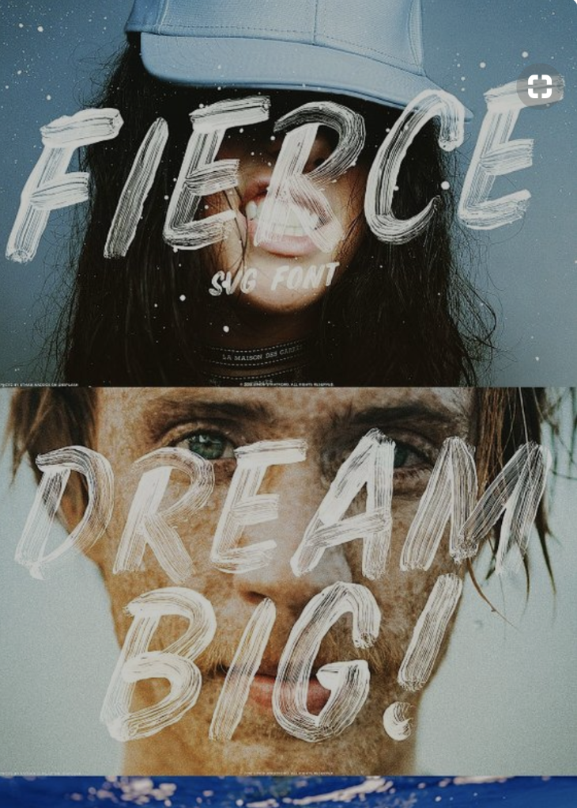
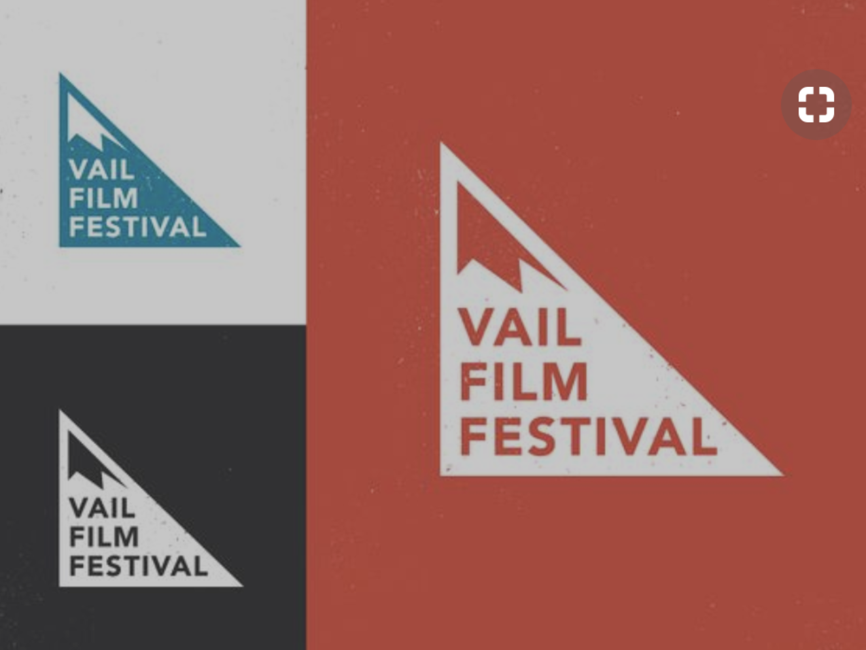
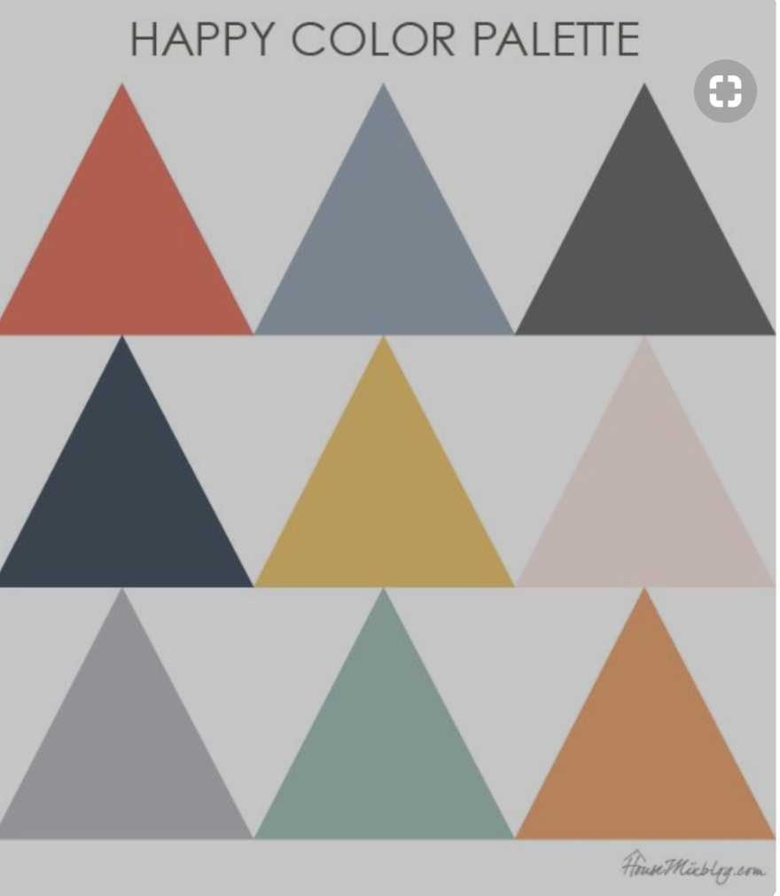
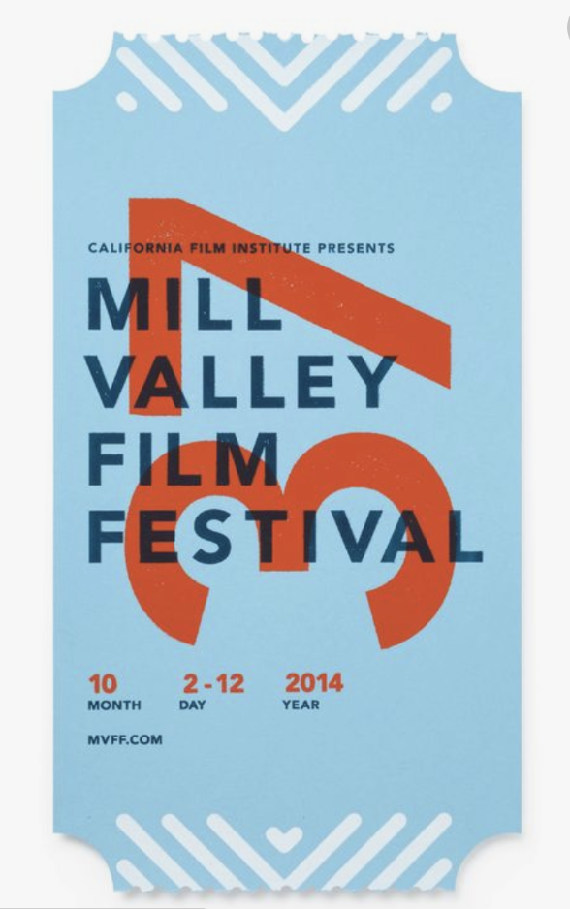
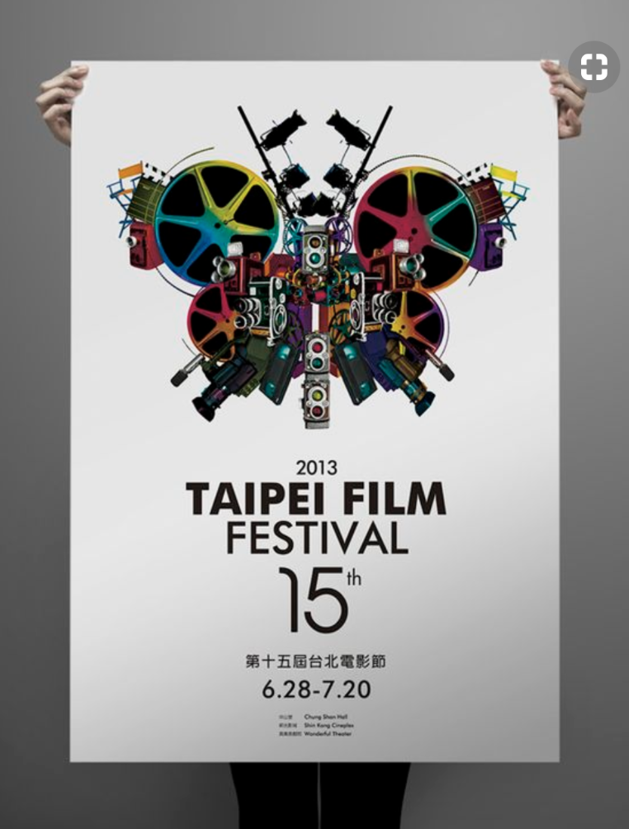
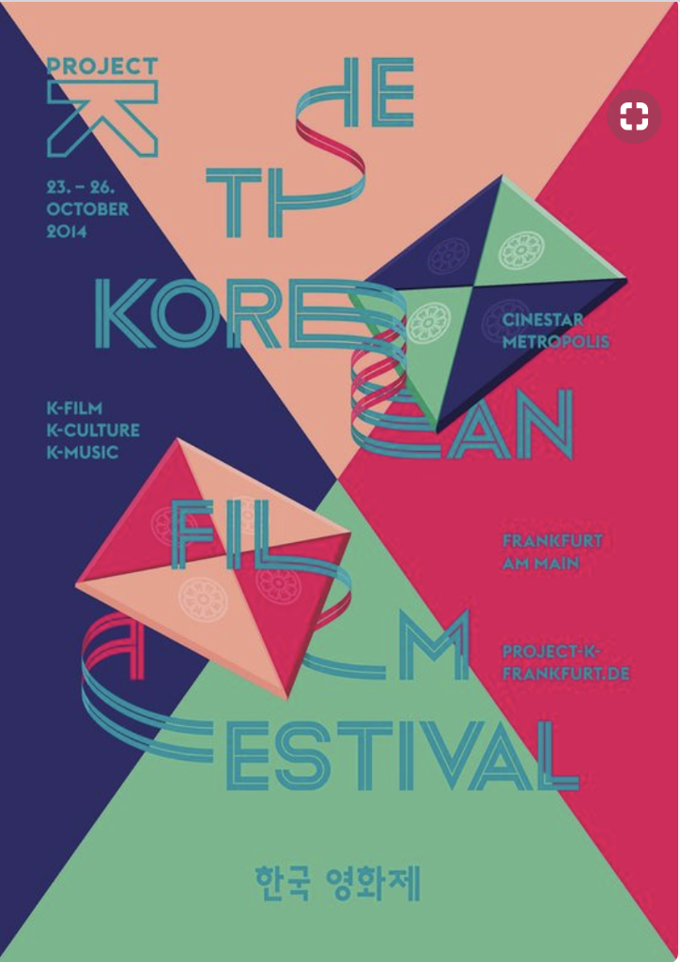
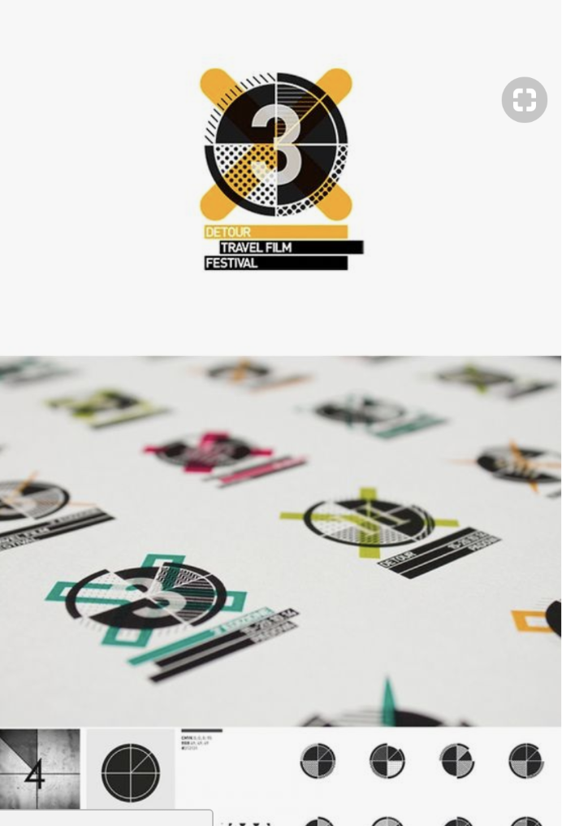
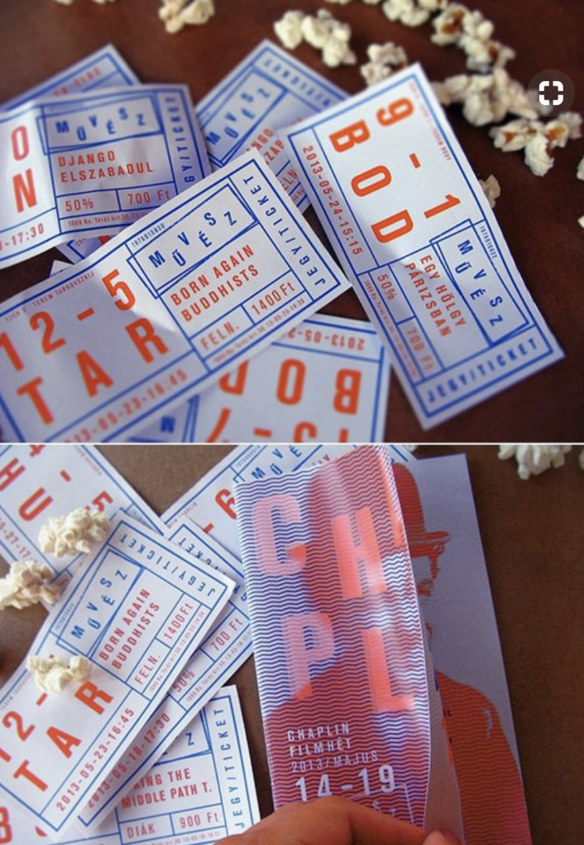



Moodboard and Competitors
Notes:
Lauren - Before we starting digitizing things, we wanted to see what other people were doing well.

Slide 10

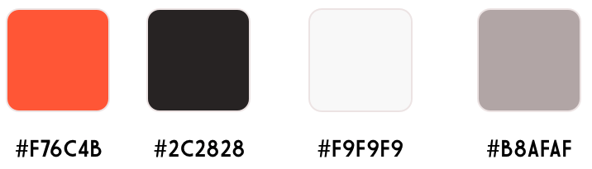
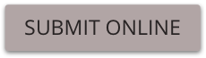








Style Guide
Open Sans Regular
OPEN SANS BOLD
Notes:
Decision for font, color, buttons
Went on Designspiration Font - 1920’s film noir typewriter, hollywood style.
Color: Dark brown reflects film negatives and also people are used to reading off lighter

Slide 11
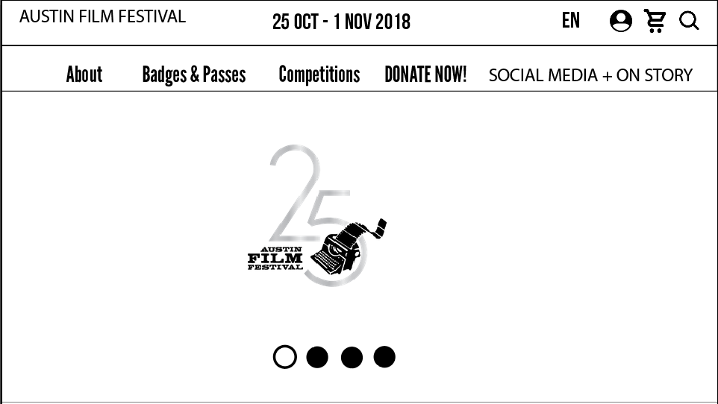
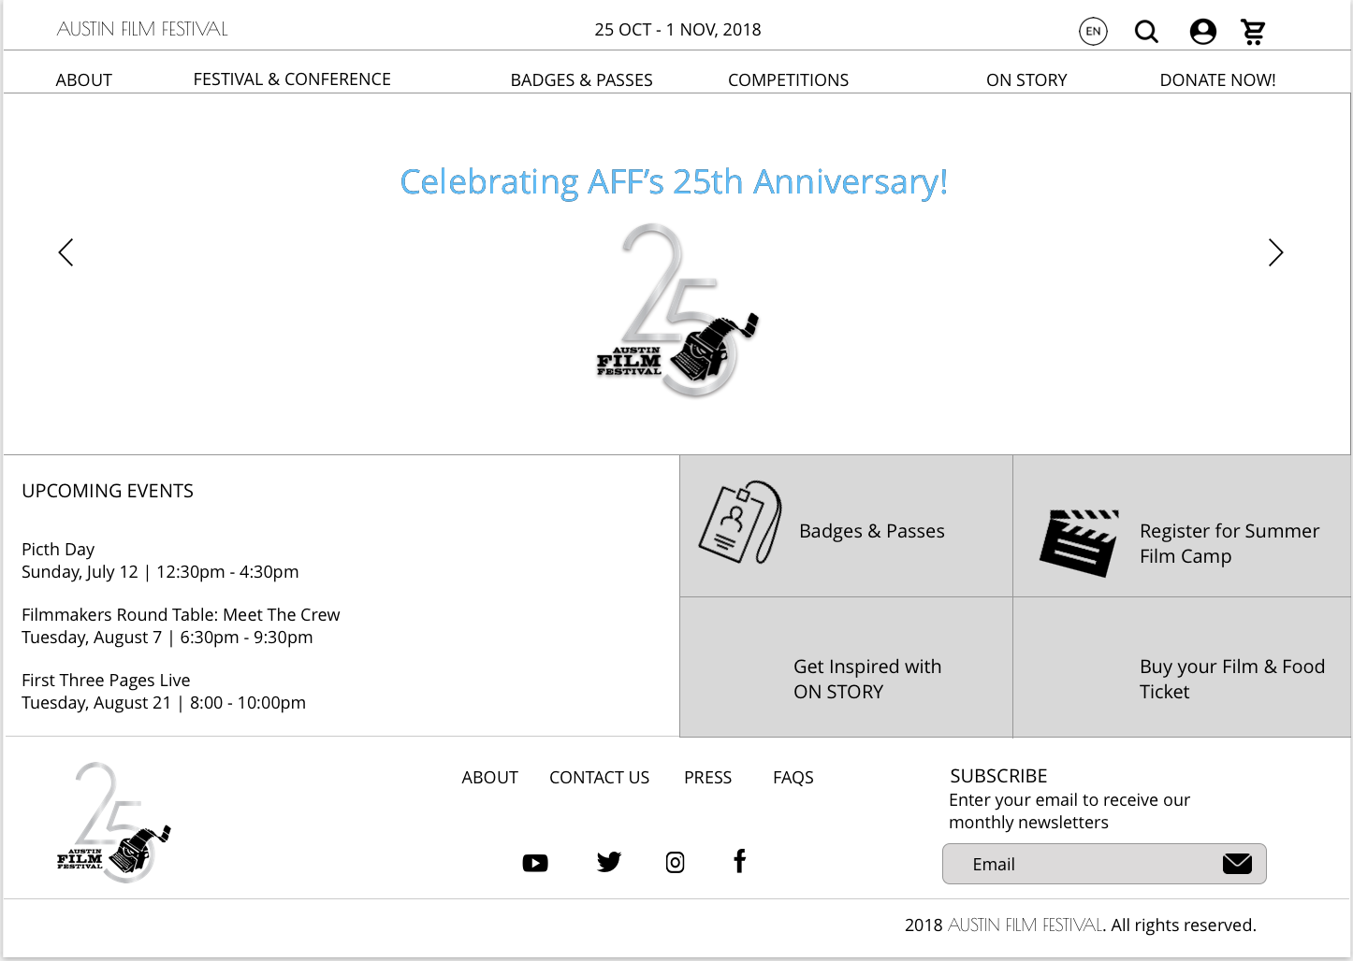
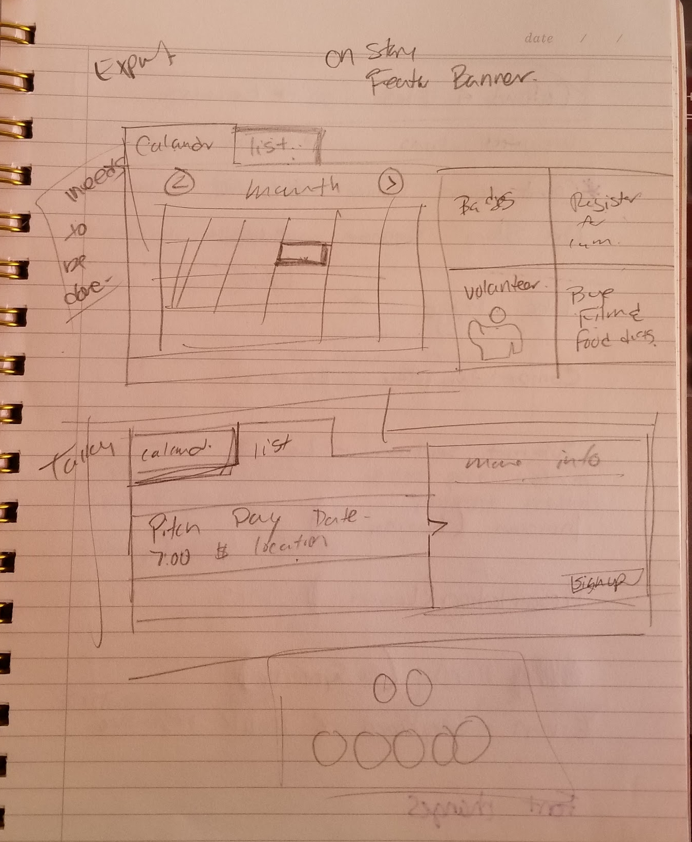
Iterate, Iterate, Iterate
Notes:
Iteration Process + Decisions regards to Style Changes to Font, Icons on the top right (weight matches, make them a working family, adding the price, Deadline Dark Grey. Want to talk to the insight how we are going back to those. Photos on the competition pages

Slide 12

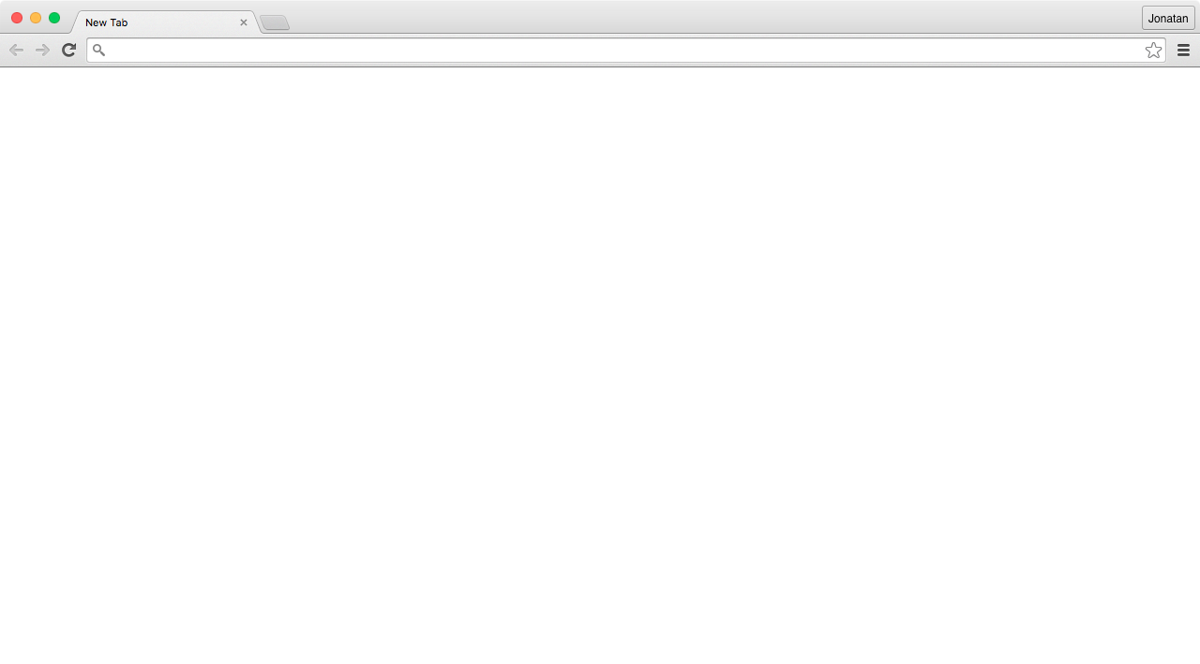
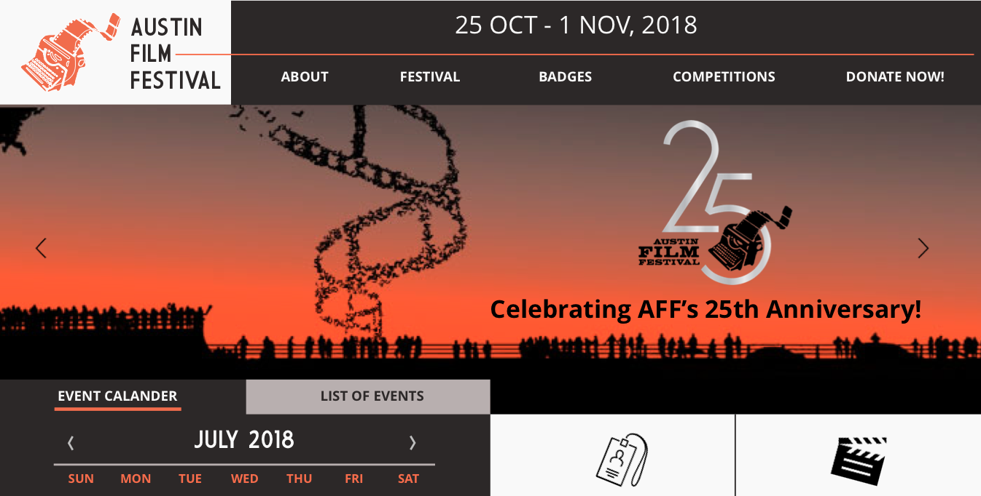

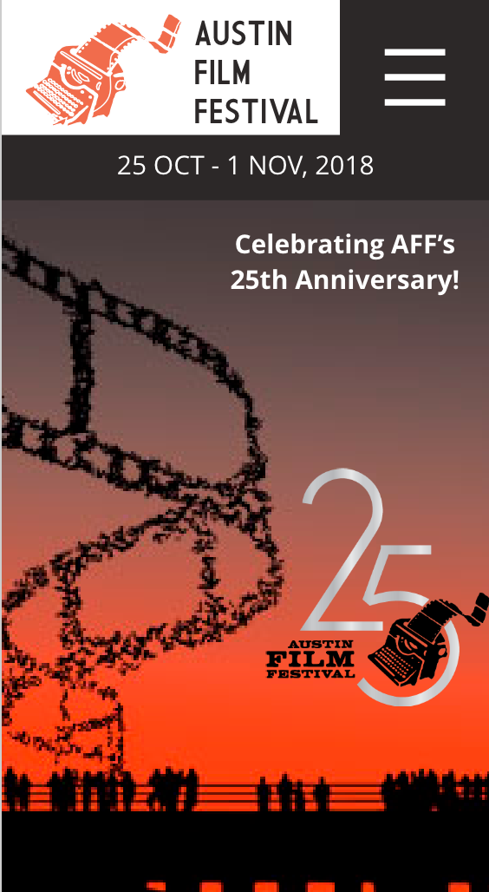
InVision
https://invis.io/B6MVLOC84X9
Notes:
Making sure we address insights.
Festival Dates and Deadlines are clear
Competition page?submission page

Slide 13
Questions?

